Slide 1

Project Title - Airbnb Hotel Booking Analysis
[Student Name - Gaurav ]

Slide 2

PROBLEM STATEMENT
The hospitality industry has undergone significant
transformation with the rise of online platforms facilitating
short-term lodging. Airbnb has revolutionized travel
accommodation, but stakeholders lack comprehensive insights
into market dynamics, pricing strategies, and customer
satisfaction factors in competitive urban markets like New York City.
Key Challenges:
Understanding pricing patterns across different neighborhoods
Identifying factors influencing customer satisfaction
Analyzing host behavior and its impact on listing performance
Optimizing availability and pricing strategies

Slide 3
Project Description
This project conducts a comprehensive analysis of New York City's Airbnb market using a
dataset of 102,000+ listings. The analysis aims to uncover valuable insights into:
Data Analysis Framework:
Data wrangling and cleaning of 26-column dataset
Exploratory Data Analysis (EDA) and statistical modeling
Neighborhood-based pricing and availability analysis
Host behavior and verification impact studies
Customer satisfaction and review pattern analysis
Key Questions Answered:
Property type distribution and market segmentation
Neighborhood performance metrics
Construction year impact on pricing
Host verification and review correlation
Price-service fee relationship analysis
Availability optimization strategies

Slide 4

WHO ARE THE END USERS?
Primary Stakeholders:
Airbnb Hosts & Property Managers
Real Estate Investors
Tourism and Hospitality Professionals
Urban Planners and Policy Makers
Travelers and Vacation Planners
Secondary Beneficiaries:
Market Researchers
Hospitality Industry Analysts
Academic Researchers
Airbnb Corporate Strategy Teams

Slide 5

Technology Used
Programming & Analysis:
Python 3.x
Pandas for data manipulation
NumPy for numerical computing
Scipy for statistical testing
Visualization & Reporting:
Matplotlib for static visualizations
Seaborn for enhanced graphics
Jupyter Notebook for interactive analysis
Data Management:
Excel data processing
Data cleaning and validation
Statistical analysis and correlation studies

Slide 6
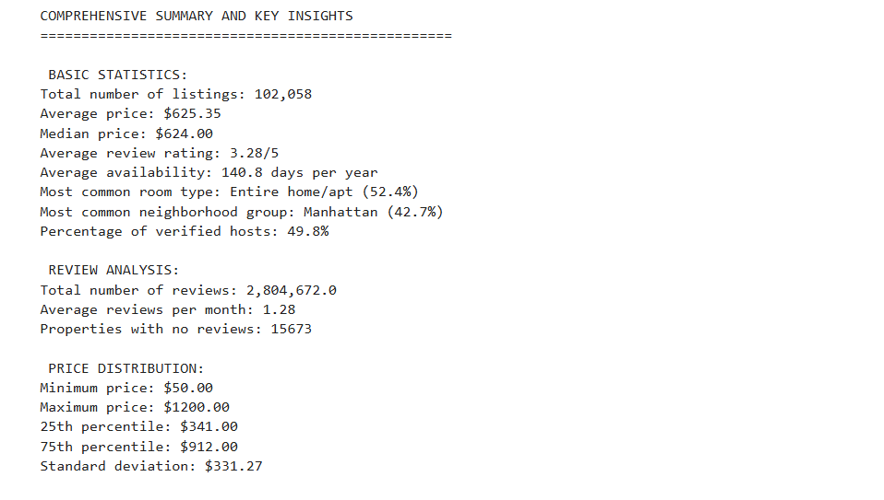
RESULTS 1

Slide 7
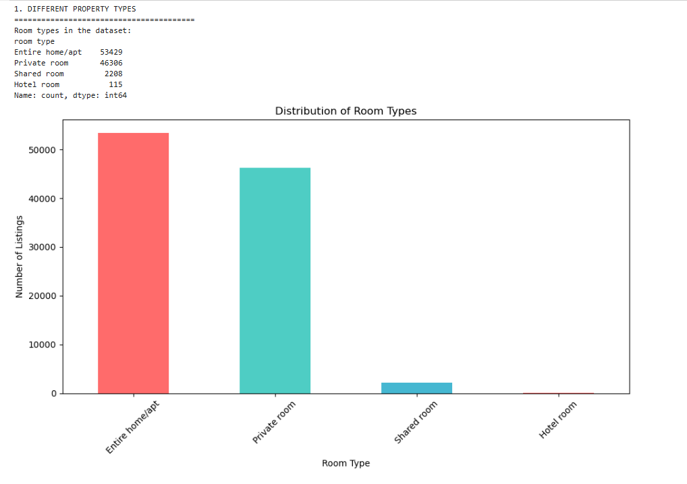
RESULTS 2

Slide 8
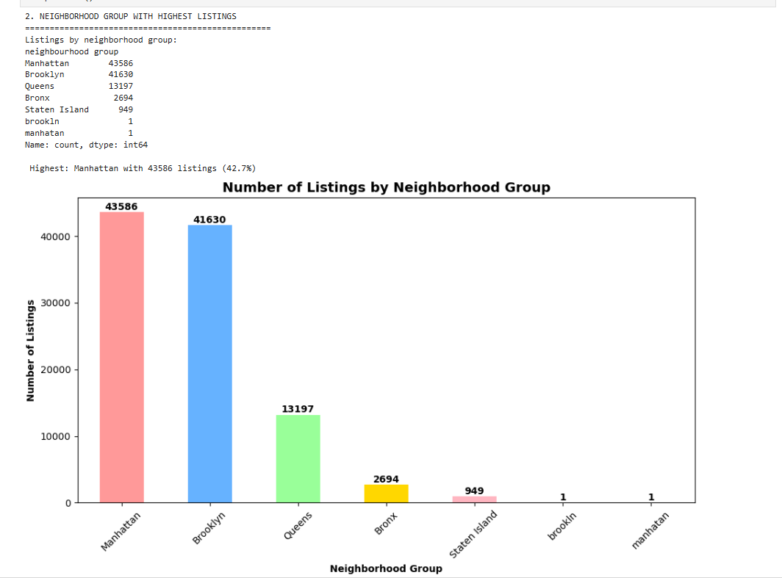
RESULTS 3

Slide 9
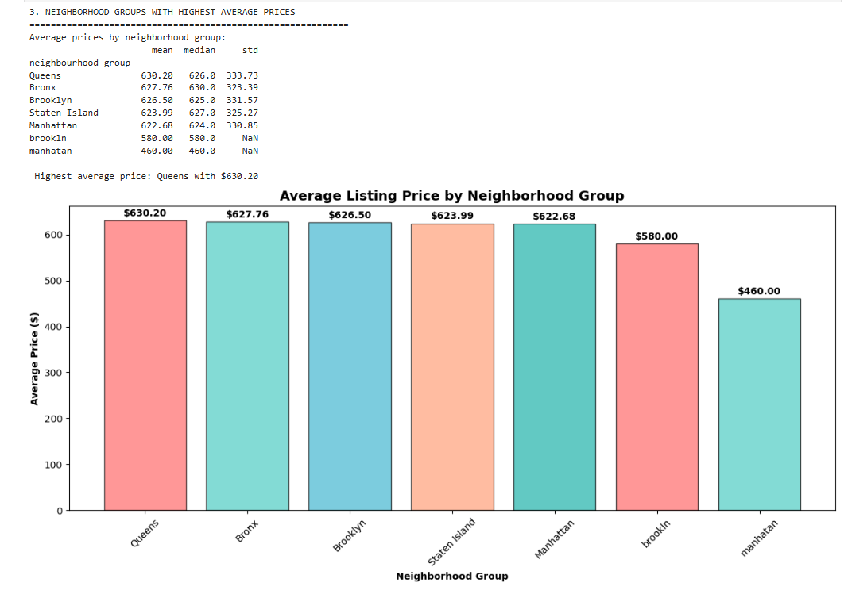
RESULTS 4

Slide 10
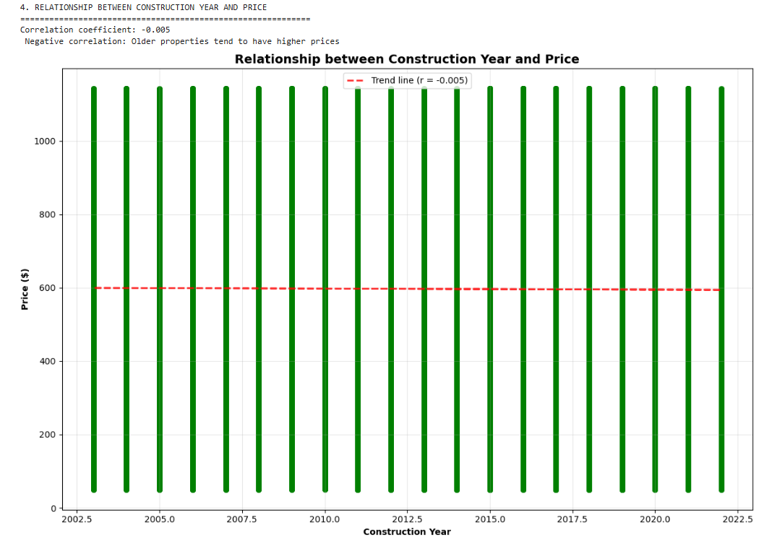
RESULTS 5

Slide 11
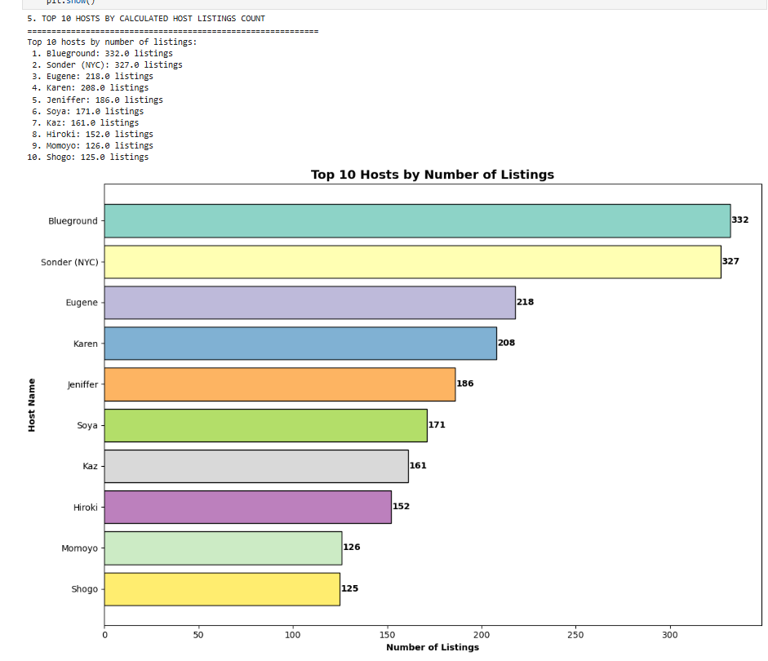
RESULTS 6

Slide 12
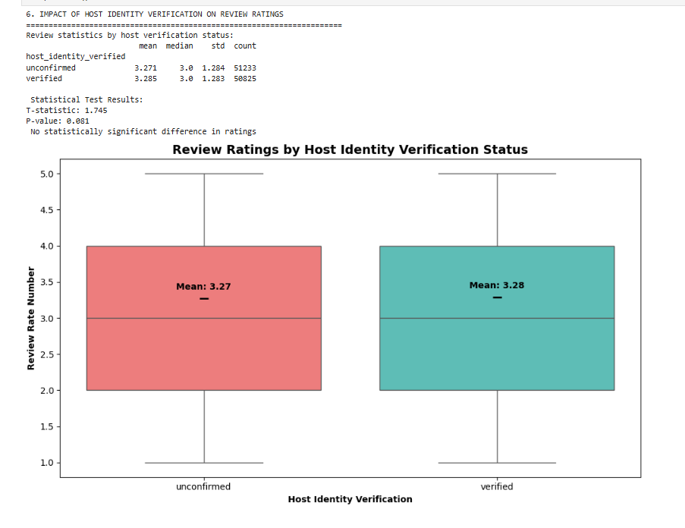
RESULTS 7

Slide 13
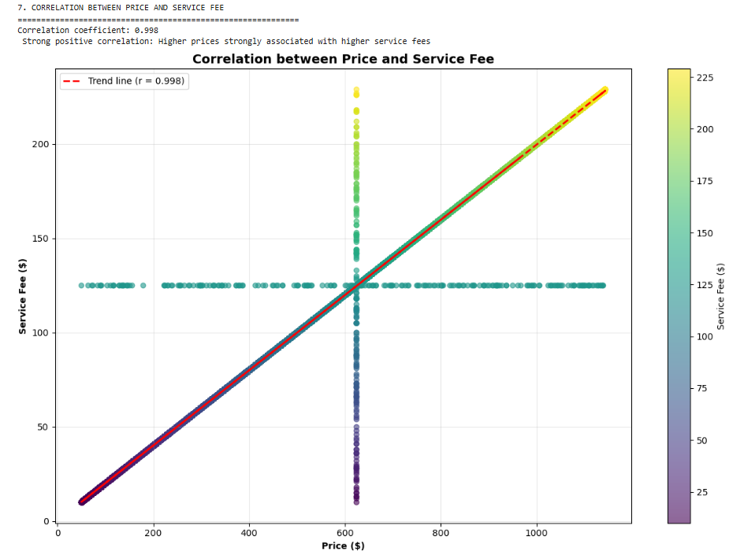
RESULTS 8

Slide 14
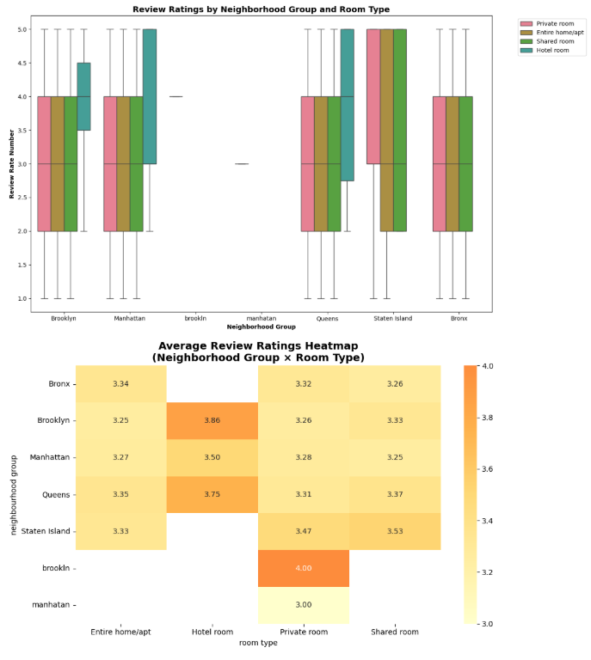
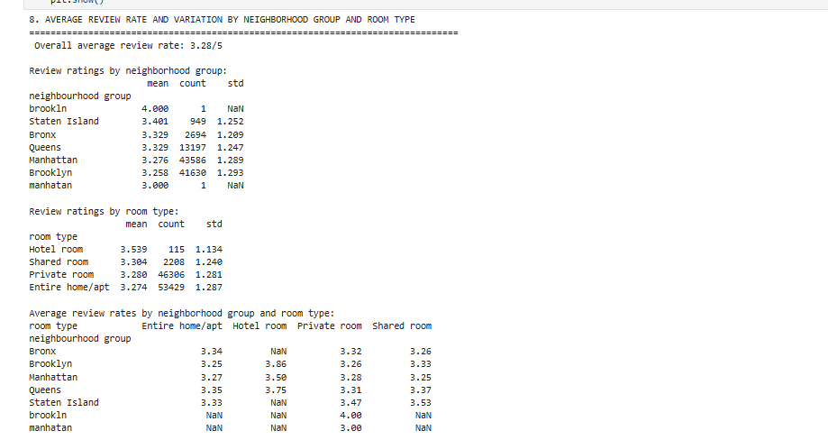
RESULTS 9

Slide 15
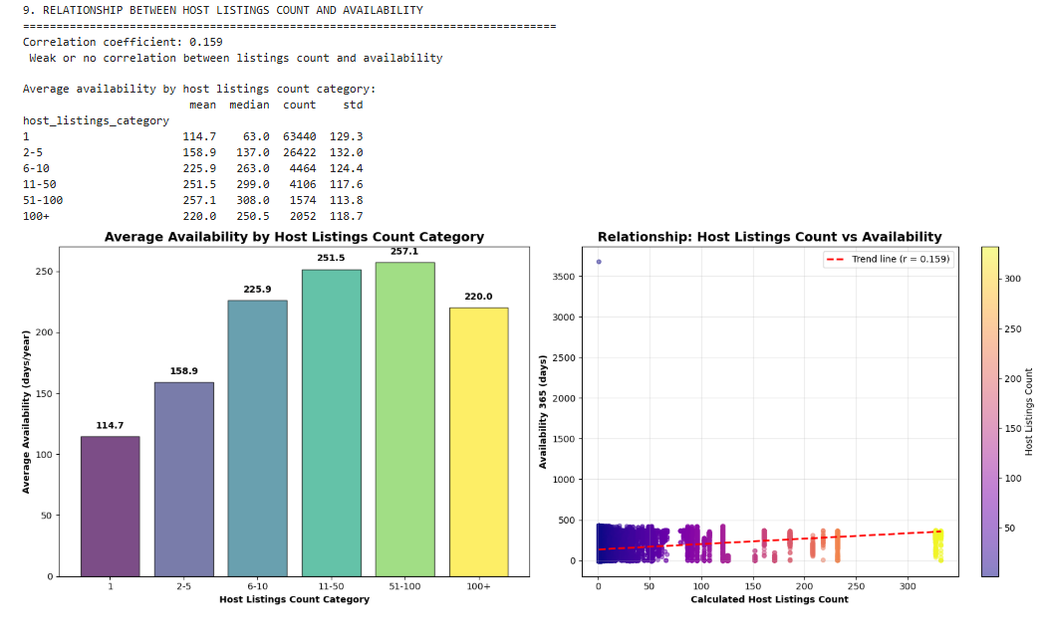
RESULTS 10

Slide 16
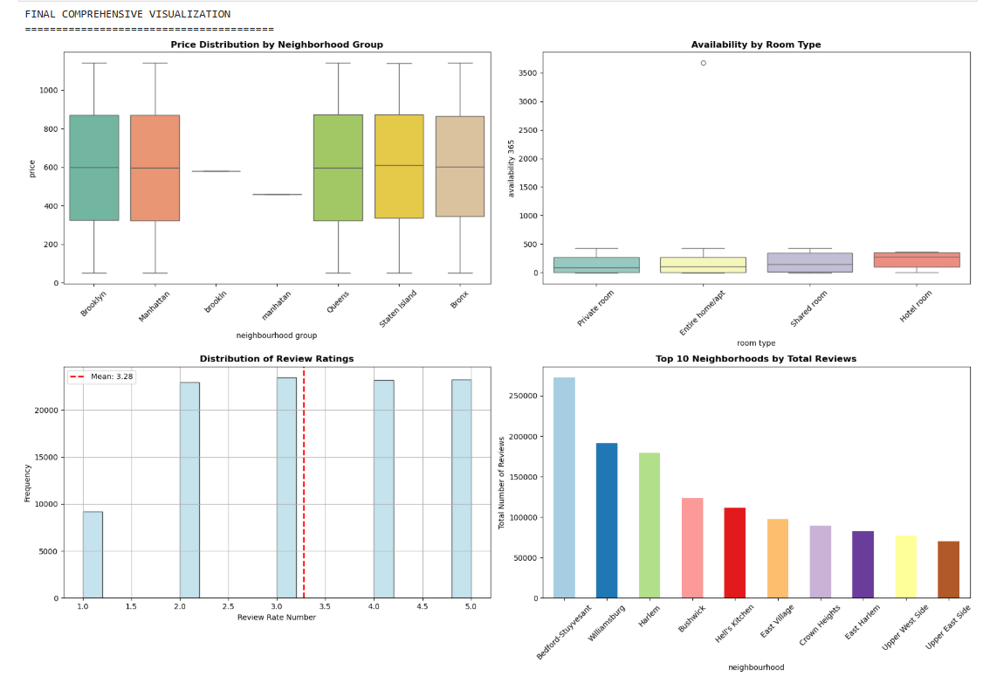
RESULTS 11

Slide 17
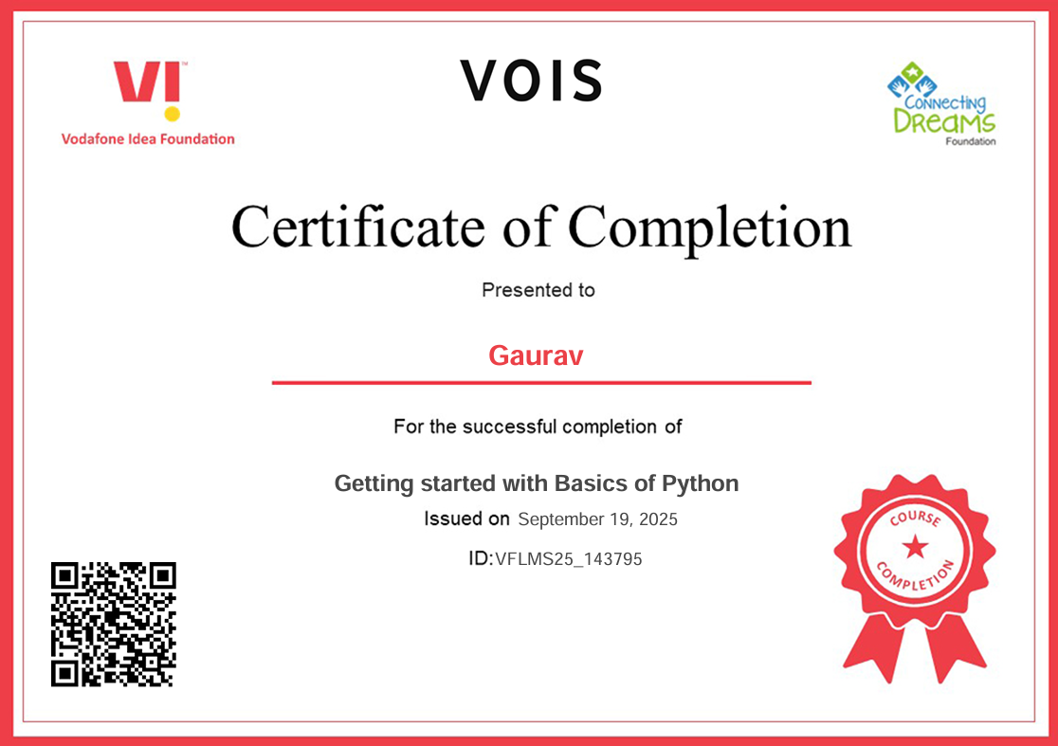
Getting started with Basics of Python

Slide 18
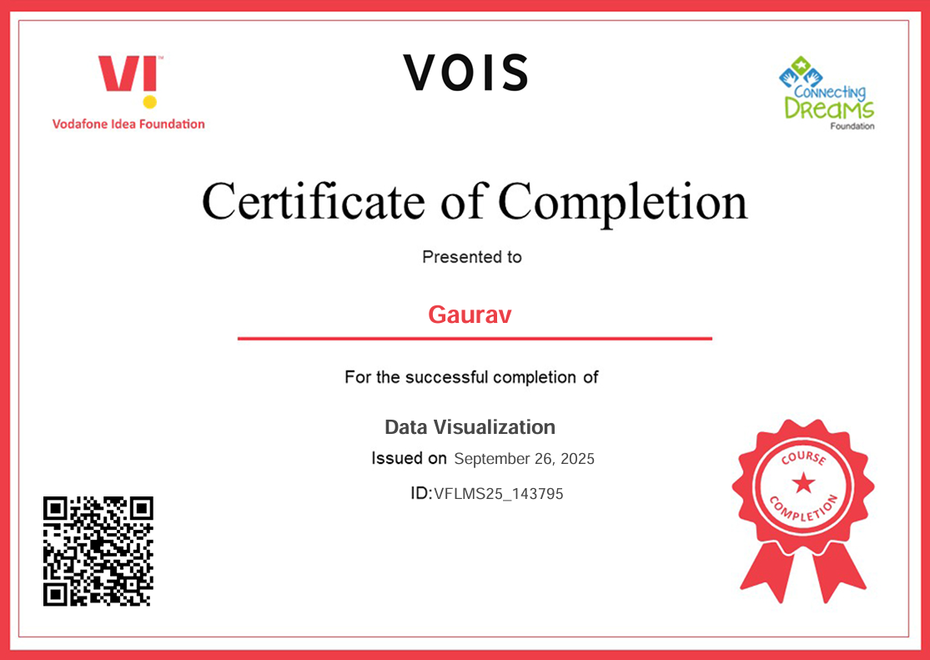
Data Visualization

Slide 19
Airbnb Hotel Booking Analysis
Gaurav
Internship ID: INTERNSHIP_172663295366ea53f910591

Slide 20
Repositori Link
https://github.com/gaurav834149/Airbnb-Hotel-Booking-Analysis.git

Slide 21
Contect information
Email – gaurav87328@gmail.com
LinkedIn Profile - Gaurav| LinkedIn
Git Hub – GitHub

Slide 22
Thank you…….
.
.

